Slide 1
Chapter 17: Protection

Slide 2
Chapter 17: Protection
Goals of Protection
Principles of Protection
Protection Rings
Domain of Protection
Access Matrix
Revocation of Access Rights

Slide 3
Objectives
Discuss the goals and principles of protection in a modern computer system
Explain how protection domains combined with an access matrix are used to specify the resources a process may access
Examine capability and language-based protection systems
Describe how protection mechanisms can mitigate system attacks

Slide 4
Goals of Protection
In one protection model, computer consists of a collection of objects, hardware or software
Each object has a unique name and can be accessed through a well-defined set of operations
Protection problem - ensure that each object is accessed correctly and only by those processes that are allowed to do so

Slide 5
Principles of Protection
Guiding principle – principle of least privilege
  Programs, users and systems should be given just enough privileges to perform their tasks
  Properly set permissions can limit damage if entity has a bug, gets abused
  Can be static (during life of system, during life of process)
  Or dynamic (changed by process as needed) – domain switching, privilege escalation
  Compartmentalization a derivative concept regarding access to data
    Process of protecting each individual system component through the use of specific permissions and access restrictions

Slide 6
Principles of Protection (Cont.)
Must consider “grain” aspect
  Rough-grained privilege management easier, simpler, but least privilege now done in large chunks
    For example, traditional Unix processes either have abilities of the associated user, or of root
  Fine-grained management more complex, more overhead, but more protective
    File ACL lists, RBAC
Domain can be user, process, procedure
Audit trail – recording all protection-orientated activities, important to understanding what happened, why, and catching things that shouldn’t
No single principle is a panacea for security vulnerabilities – need defense in depth

Slide 7
Protection Rings
Components ordered by amount of privilege and protected from each other
  For example, the kernel is in one ring and user applications in another
  This privilege separation requires hardware support
In order to return to a higher privilege level, code usually calls a special instruction, sometimes referred to as a gate, which provides a portal between rings. The syscall instruction (in Intel) is one example
Another way of ending up in a more privileged ring is on the occurrence of a processor trap or an interrupt.
Hypervisors introduced the need for yet another ring
ARMv7 processors added TrustZone(TZ) ring to protect crypto functions with access via new Secure Monitor Call (SMC) instruction

Slide 8
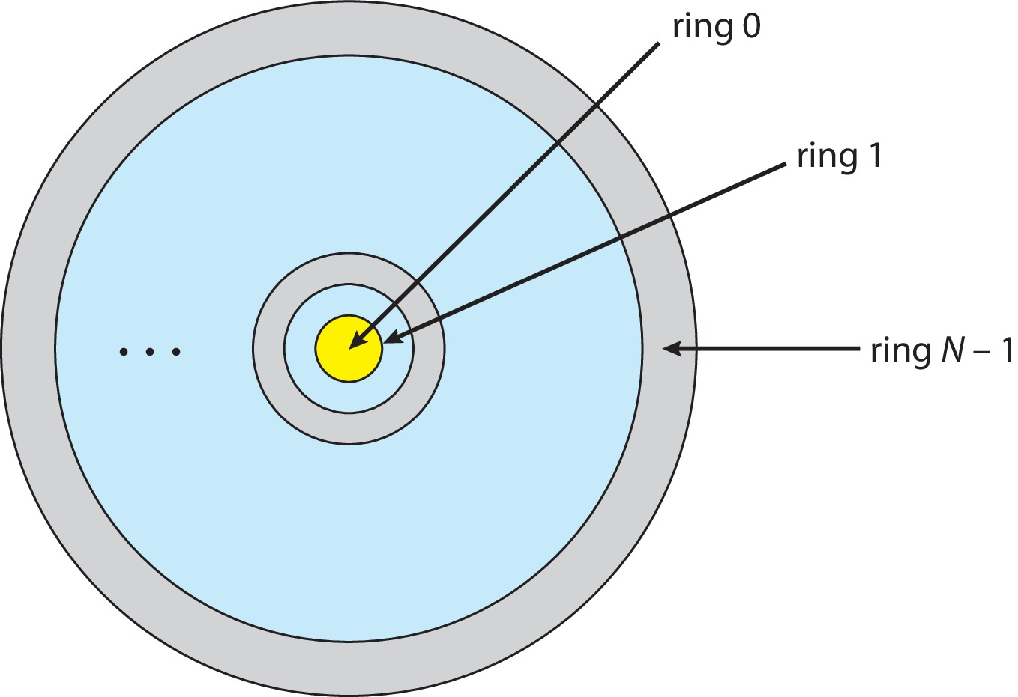
Protection Rings (MULTICS)
Let D_{i} and D_{j} be any two domain rings
If j < I ⇒ D_{i} ⊆ D_{j}

Slide 9
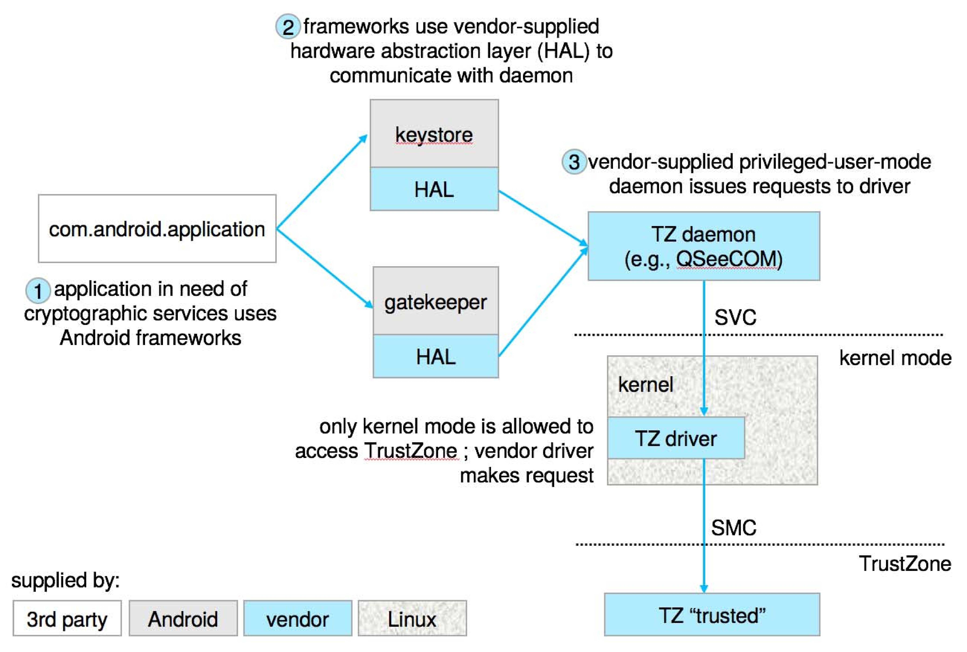
Android use of TrustZone

Slide 10
1 Domain of Protection
Rings of protection separate functions into domains and order them hierarchically
Computer can be treated as processes and objects
  Hardware objects (such as devices) and software objects (such as files, programs, semaphores
Process for example should only have access to objects it currently requires to complete its task – the need-to-know principle

Slide 11
Domain of Protection (Cont.)
Implementation can be via process operating in a protection domain
  Specifies resources process may access
  Each domain specifies set of objects and types of operations on them
  Ability to execute an operation on an object is an access right
    <object-name, rights-set>
  Domains may share access rights
  Associations can be static or dynamic
  If dynamic, processes can domain switch

Slide 12
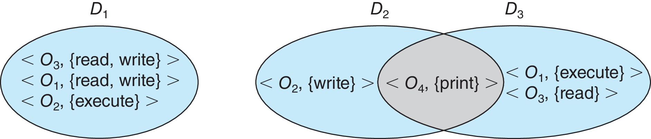
Domain Structure
Access-right = <object-name, rights-set>
where rights-set is a subset of all valid operations that can be performed on the object
Domain = set of access-rights

Slide 13
Domain Implementation (UNIX)
Domain = user-id
Domain switch accomplished via file system
  Each file has associated with it a domain bit (setuid bit)
  When file is executed and setuid = on, then user-id is set to owner of the file being executed
  When execution completes user-id is reset
Domain switch accomplished via passwords
  su command temporarily switches to another user’s domain when other domain’s password provided
Domain switching via commands
  sudo command prefix executes specified command in another domain (if original domain has privilege or password given)

Slide 14
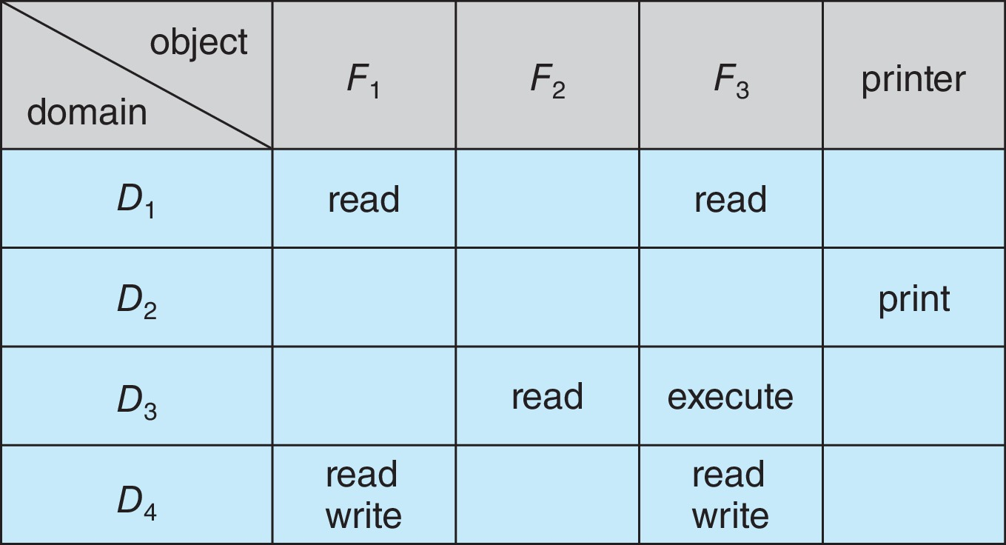
Access Matrix
View protection as a matrix (access matrix)
Rows represent domains
Columns represent objects
Access(i, j) is the set of operations that a process executing in Domain_{i} can invoke on Object_{j}

Slide 15
Use of Access Matrix
If a process in Domain D_{i} tries to do “op” on object O_{j}, then “op” must be in the access matrix
User who creates object can define access column for that object
Can be expanded to dynamic protection
  Operations to add, delete access rights
  Special access rights:
    owner of O_{i}
    copy op from O_{i} to O_{j} (denoted by “*”)
    control – D_{i} can modify D_{j} access rights
    transfer – switch from domain D_{i} to D_{j}
  Copy and Owner applicable to an object
  Control applicable to domain object

Slide 16
Use of Access Matrix (Cont.)
Access matrix design separates mechanism from policy
  Mechanism
    Operating system provides access-matrix + rules
    If ensures that the matrix is only manipulated by authorized agents and that rules are strictly enforced
  Policy
    User dictates policy
    Who can access what object and in what mode
But doesn’t solve the general confinement problem

Slide 17
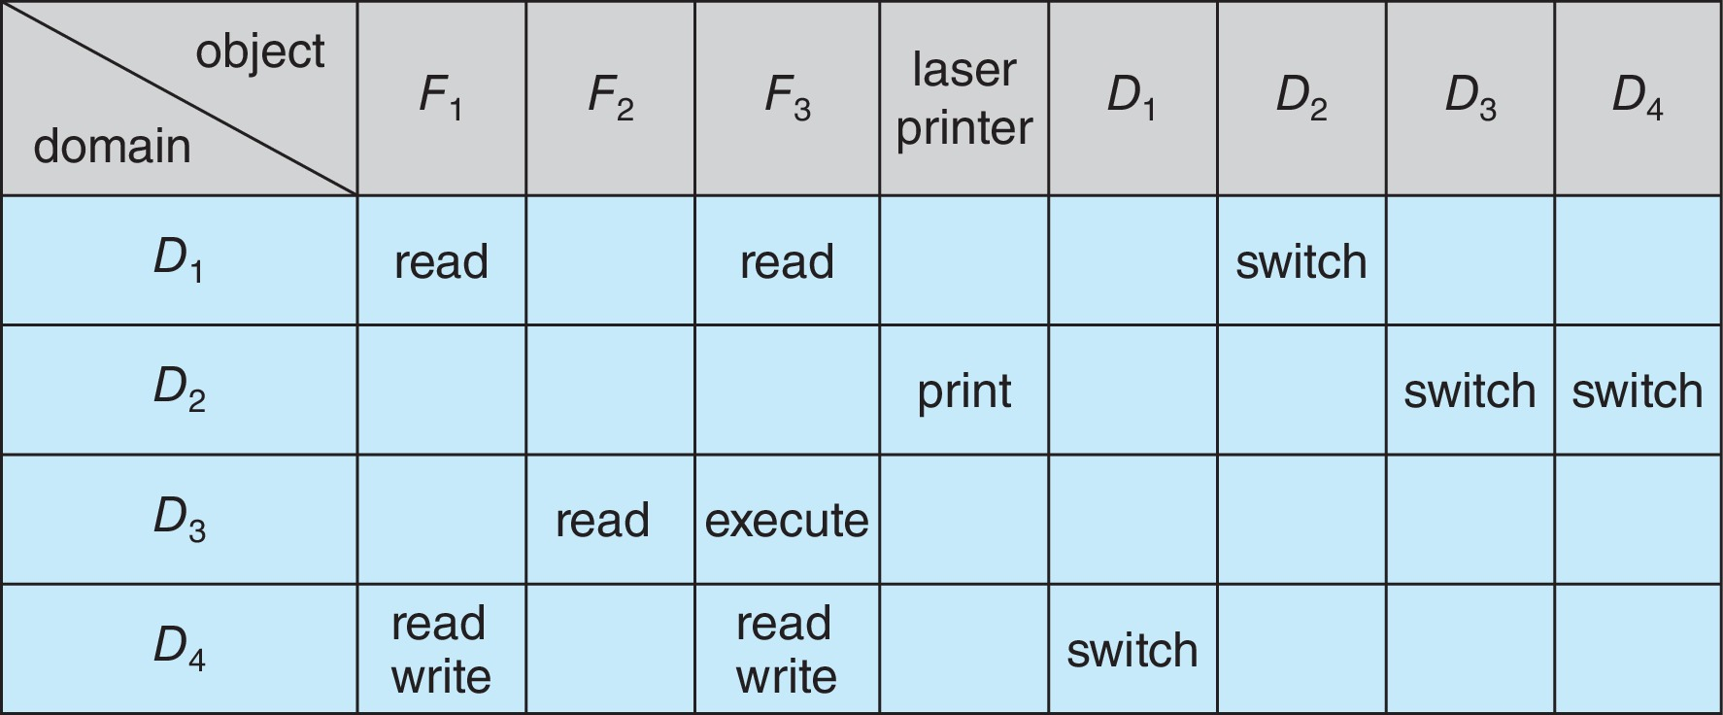
Access Matrix of Figure A with
Domains as Objects

Slide 18
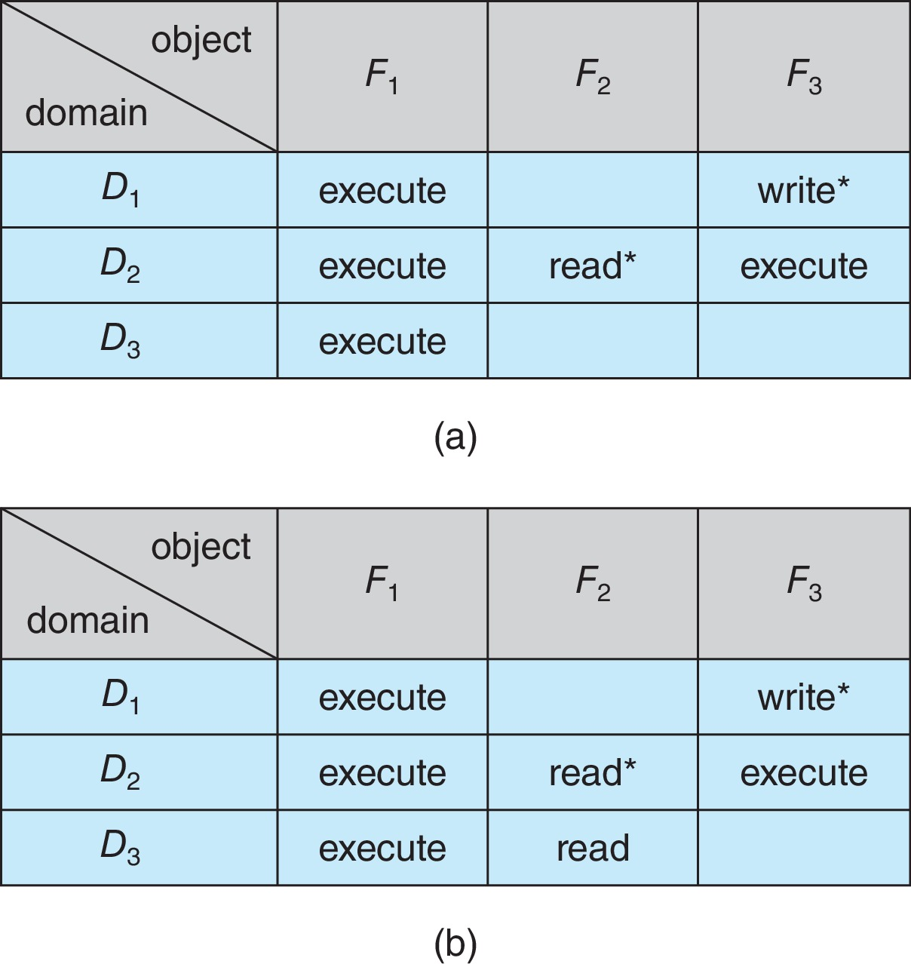
Access Matrix with Copy Rights

Slide 19
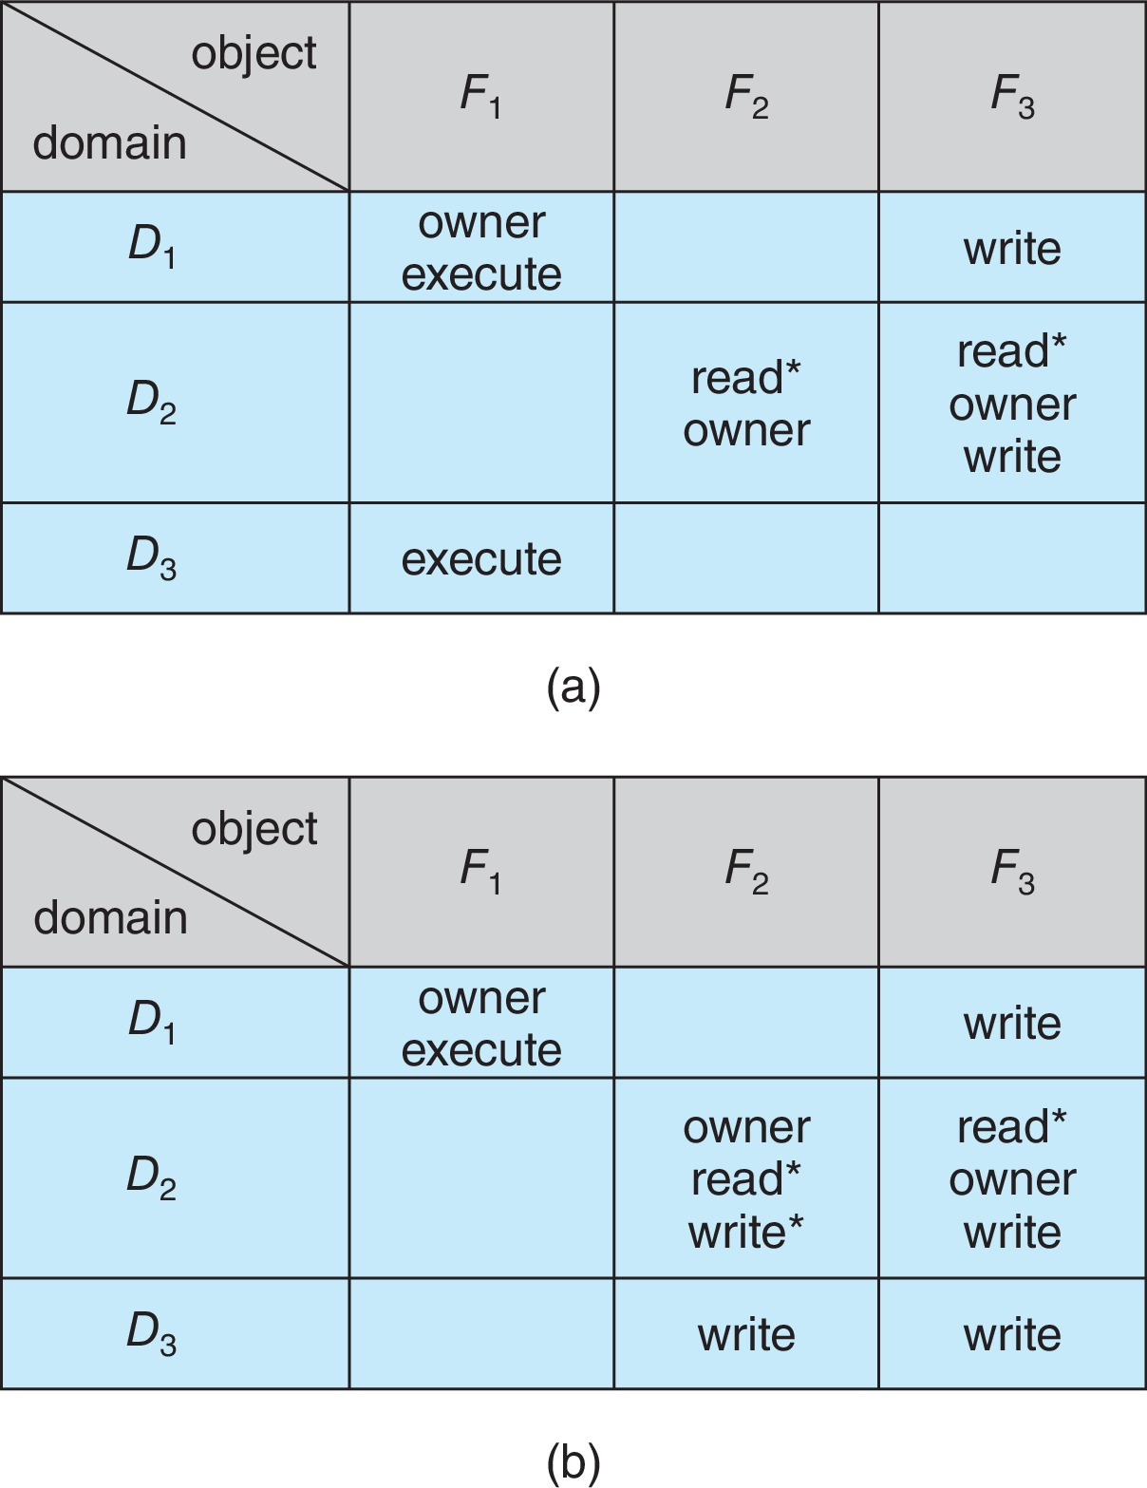
Access Matrix With Owner Rights

Slide 20
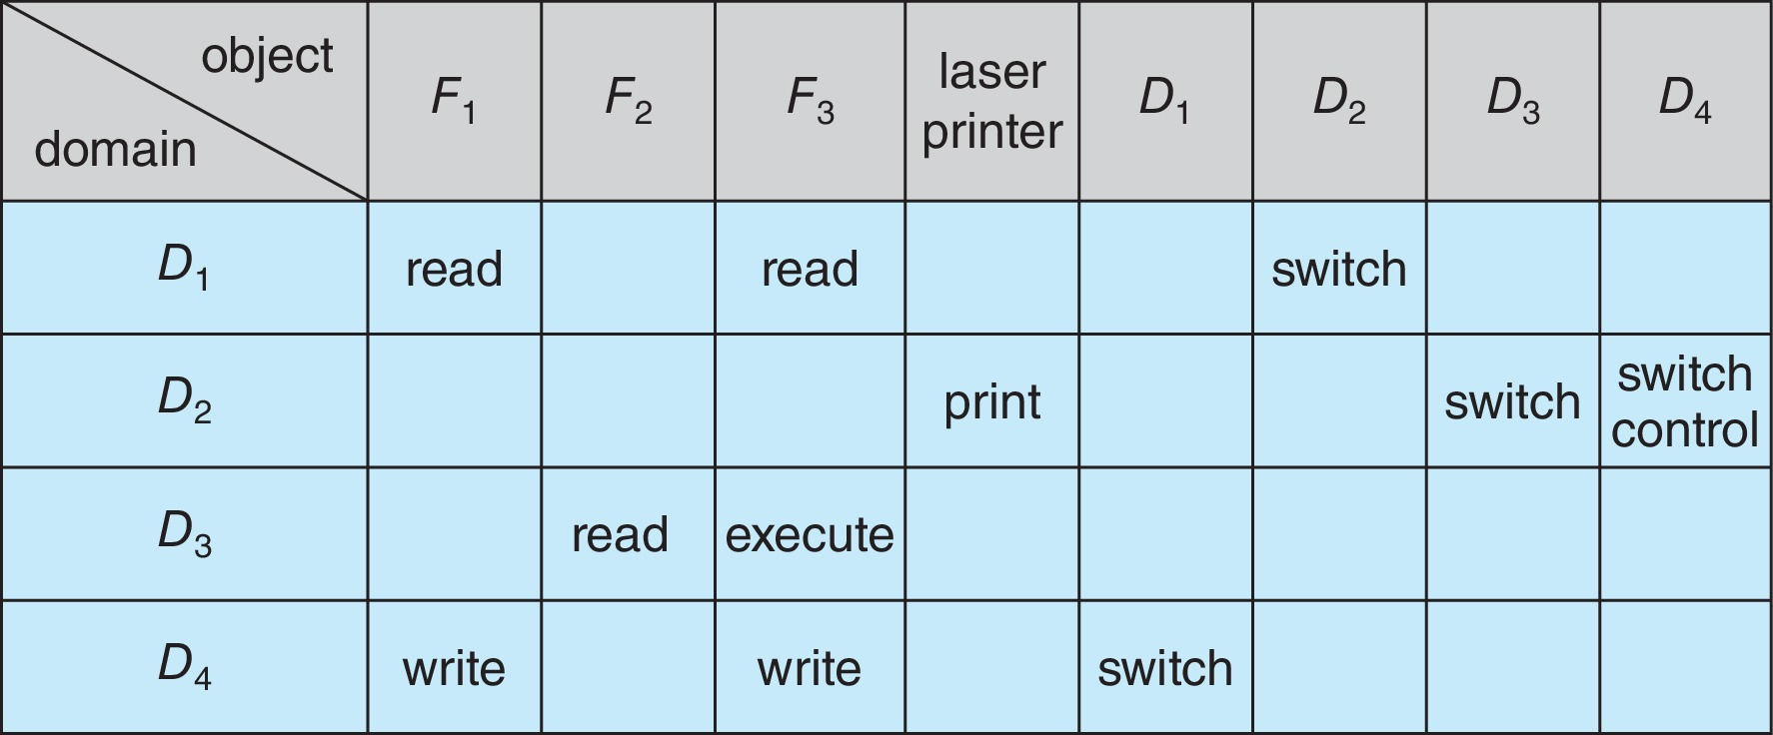
Modified Access Matrix of Figure B

Slide 21
Revocation of Access Rights
Various options to remove the access right of a domain to an object
  Immediate vs. delayed
  Selective vs. general
  Partial vs. total
  Temporary vs. permanent
Access List – Delete access rights from access list
  Simple – search access list and remove entry
  Immediate, general or selective, total or partial, permanent or temporary

Slide 22
End of Chapter 17

